Slide 1
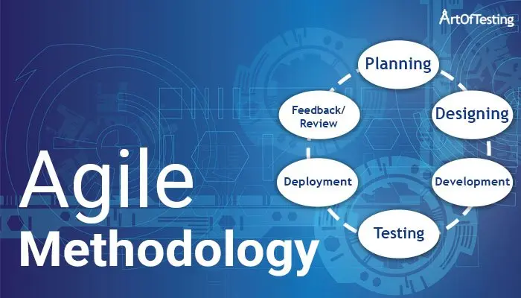
Agile methodology

Slide 2

introduction
Agile Methodology is a Software methodology to build a software incrementally using short iterations of 1 to 4 weeks so that the development is align with the changing business needs.
Agile methodology is a way to manage a project by breaking it up into several phases. It involves constant collaboration with stakeholders and continuous improvement at every stage. Once the work begins, teams cycle through a process of planning, executing, evaluating.
It is the most popular approaches to project management due to its flexibility, adaptability to change, and high level of customer input

Slide 3
Roles in Agile methodology
There are two roles in agile methodology;
1. Scrum Master
2. Product Owner

Slide 4
Scrum master
Scrum Master is like a Team Leader, Facility provider who enable the close cooperation between the roles and functions.
They are guardians of process, givers of feedback, and mentors to junior team members. They check in with team members , and make sure that tasks are being complete on target.

Slide 5
Product owner
One who runs the product from business perspective. Product owner has a vision for the end product and a sense of how it will fit into the company’s long-term goals. This person will need to direct communication efforts, altering the team to major developments.

Slide 6
Advantages of Agile methodology
Rapid customer satisfaction.
Regular Interaction.
1-4 weeks for deliver the product.
Cooperation is increased between user and developer.
Changes will be occurring frequently.

Slide 7
disadvantages of agile methodology
Not used for small projects.
Agile Methodology Documentation is less.
Lack of intensity.
It requires Experts to do the work.
Cost is high.

Slide 8
Principles in agile methodology
Customer Satisfaction
Welcome Change
Deliver the working software frequently
Collaboration
Motivation
Face to Face conversation
Maintain constant way
Monitoring
Simplicity
Self organized teams
Review the work regularly
Major the programs as per working software

Slide 9
Characteristics
Incremental/Iterative and Ready to evolve.
Face to face communication.
Feed back loop.

Slide 10
Extreme programming
Extreme programming(XP) is an Agile Software development framework that aims to produce higher Quality Software, and Higher Quality of life for the Development team. It is the most specific of the agile frameworks regarding appropriate engineering practices for software development.
It is built upon values, principles, and practices, and its goal to allow small to mid-sized teams to produce high-quality software and adapt to evolving and changing requirements.

Slide 11
Values in Extreme programming
Communication
Simplicity
Feedback
Courage
Respect

Slide 12

Principles of extreme programming
Rapid feedback
Assume simplicity
Incremental change
Embracing change
Quality work

Slide 13

Kanban
Kanban is a popular framework used to implement agile and DevOps software development. It requires real-time communication of capacity and full transparency of work. It allowing team members to see the state of every piece of work at any time.

Slide 14
Principles of kanban
Visualize
Visualize(the work, the workflow, and the business risks).
Limit
Limit Work-In-Progress(WIP).
Manage
Manage flow.
Make
Make policies explicit.
Implement
Implement feedback loops.
Improve
Improve collaboratively, evolve experimentally.

Slide 15
THANK YOU

